Slide 1
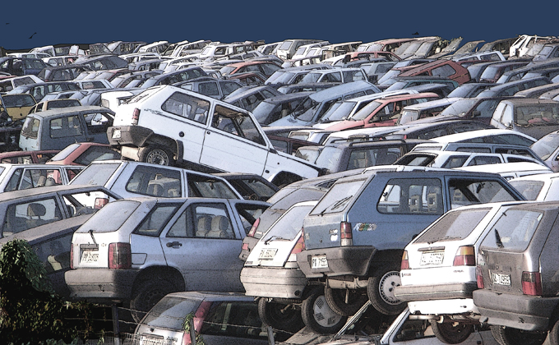
NCSU Parking Problem: A Comprehensive Solution to the Parking Woes Faced by People Coming to NCSU Campus
CSC 510 – Apr 21 Presentation
Group M
Ahmad Saad Khan, Krishna Agarwala, Nikhil Raina, Snehasis Ghosh

Slide 2
Why?
Parking is a menace
Searching for parking facilities increase peak traffic flow by 25-40% ^{[1]}
Downtown cars cruising for parking spots - 30% ^{[2]}
Loss of important resources - time, gas, CO₂ ^{[3]}
Cruising Distance | 950,000 miles | 38 trips around the earth
Time | 95,000 h | 11 years
Gasoline | 47,000 gallons | 177,660 l
CO² Production | 730 tons
Table 1: Annual figures in Westwood Village, LA (2007

Slide 3

Why… Continued
Increasing students ⇔ Increasing traffic
Location
Visitors
Game Day events
We know a few students
who park at the Food Lion
We are glued to our phones
constantly.

Slide 4
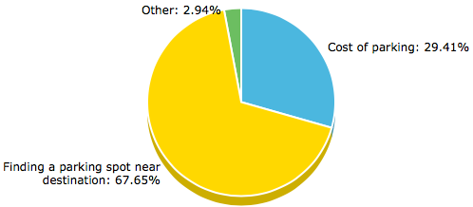
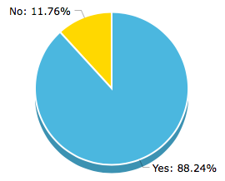
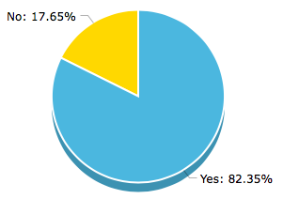
Analysis
Problem with bringing a car to the campus
Is a mobile app required?
Is a parking ticket tracking/payment app required?

Slide 5

Possible Solutions
Problem has been extensively studied but solutions are few and far in between.
No research done for campus specific parking problem.
According to the survey, we needed to integrate both the parking solution and add feature of tracking parking fines and violations.
Web app or mobile app?

Slide 6

Our Solution
We decided to build an Android app, taking into account the percentage of mobile users and which OS they use.
76% of mobile users used Android phone in 2014 in the US.
We would integrate both the parking solution and tracking of fines and payments into a single app.

Slide 7

The 3 Solutions
Now that we had decided to base our solutions on building an Android app, the 3 solutions became fairly obvious based on our Feb 1 results.
Took inspiration from the TransLoc app for tracking bus routes and real-time bus tracking
The 3 highlighting features are:
Standalone Android Application
Authorization feature
Parking Management System

Slide 8
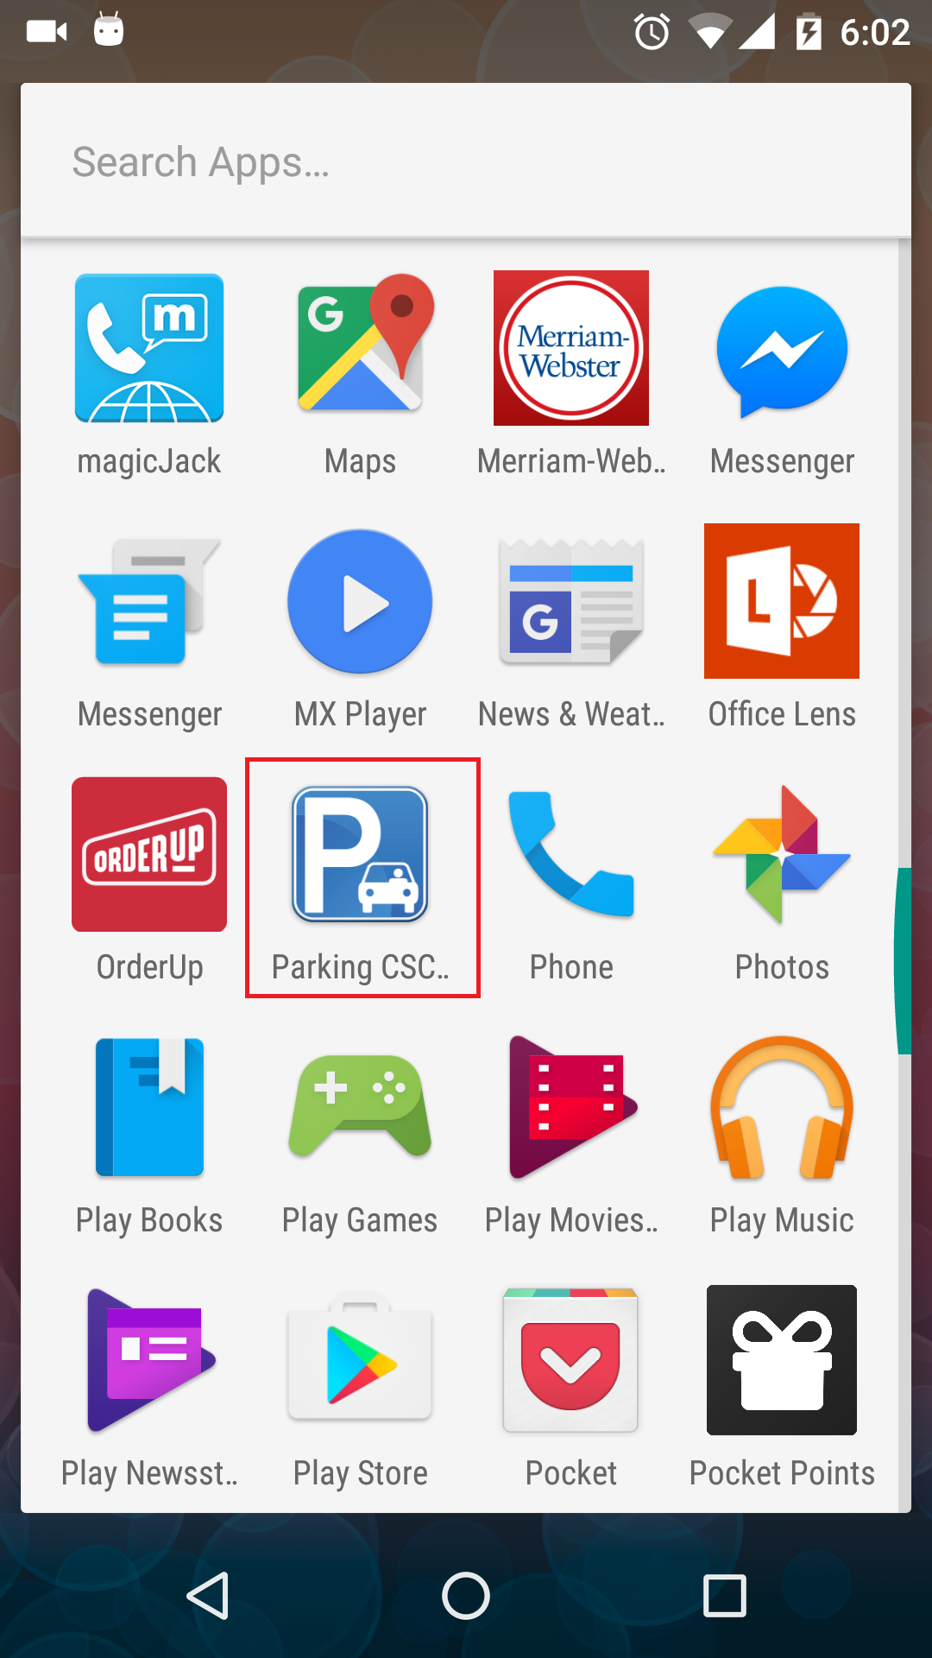
1. Standalone Parking App
The most simple of all solutions.
No need of login, open app and check the parking lots.
Anyone can open the app
Use of Google Maps APIs
All the NCSU parking lots included by tying into the geo-locations obtained from the transport department.
Also tied with Google Navigation to find shortest route to any parking lot you choose.

Slide 9
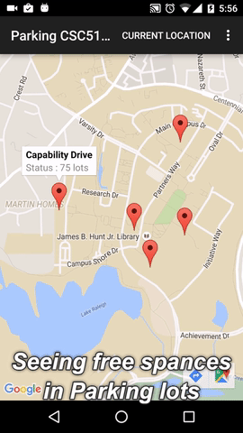
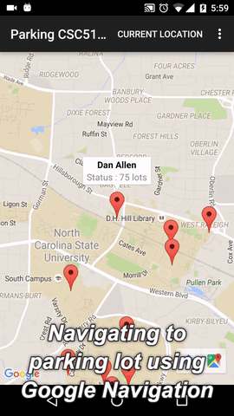

Slide 10
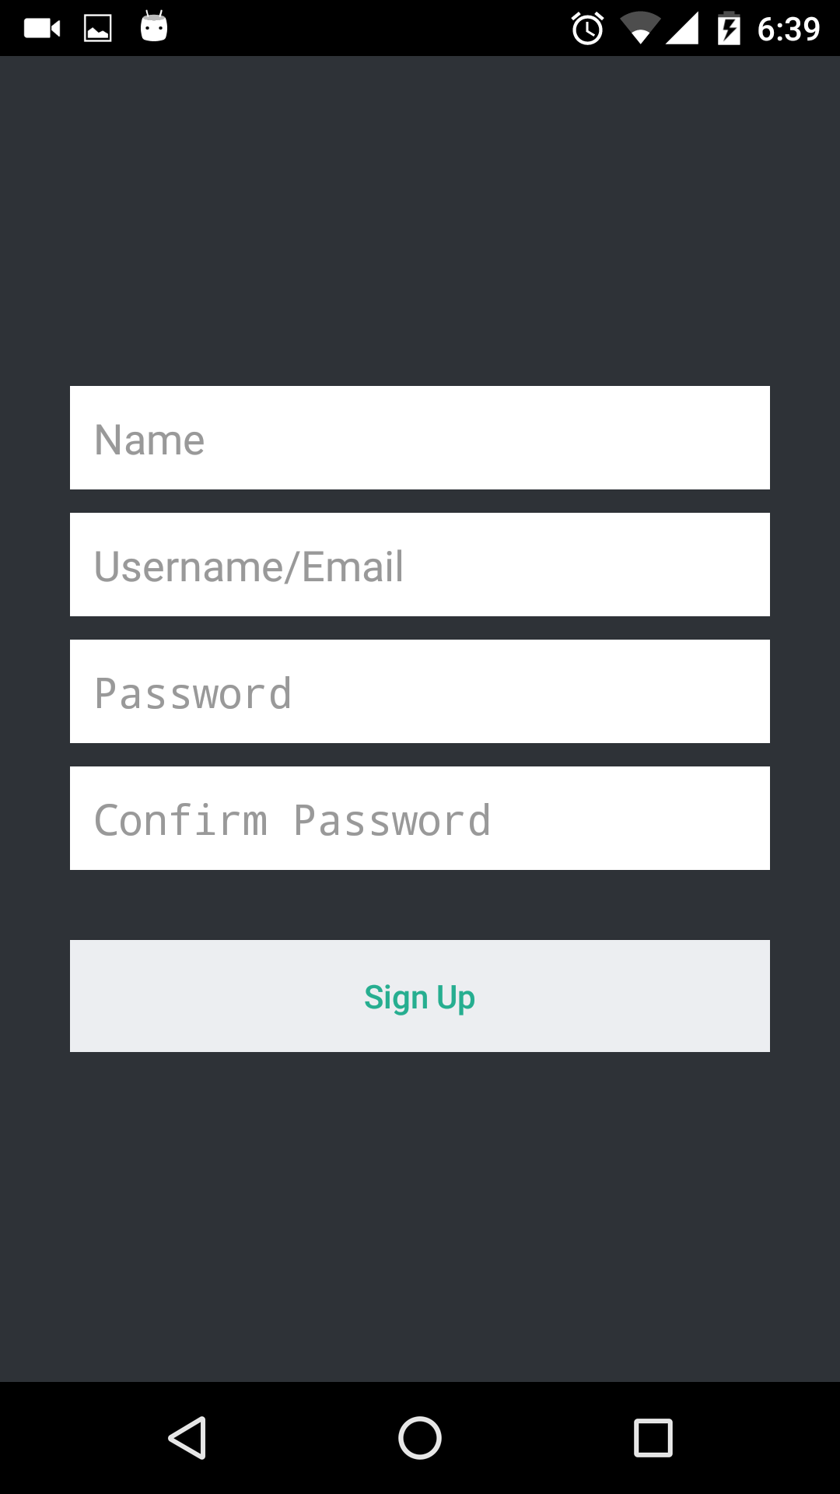
2. Authorization Feature
Aimed towards users who come to campus frequently and hence may use the app frequently.
Requires users to sign-up and login to the app.
User can “favourite” their frequently used parking spot to automatically open the app to that parking lot.
User also enjoys full features on standalone parking app.
No need to open app, find your desired parking lot and then check for available spaces, signup once and you’re good to go.

Slide 11
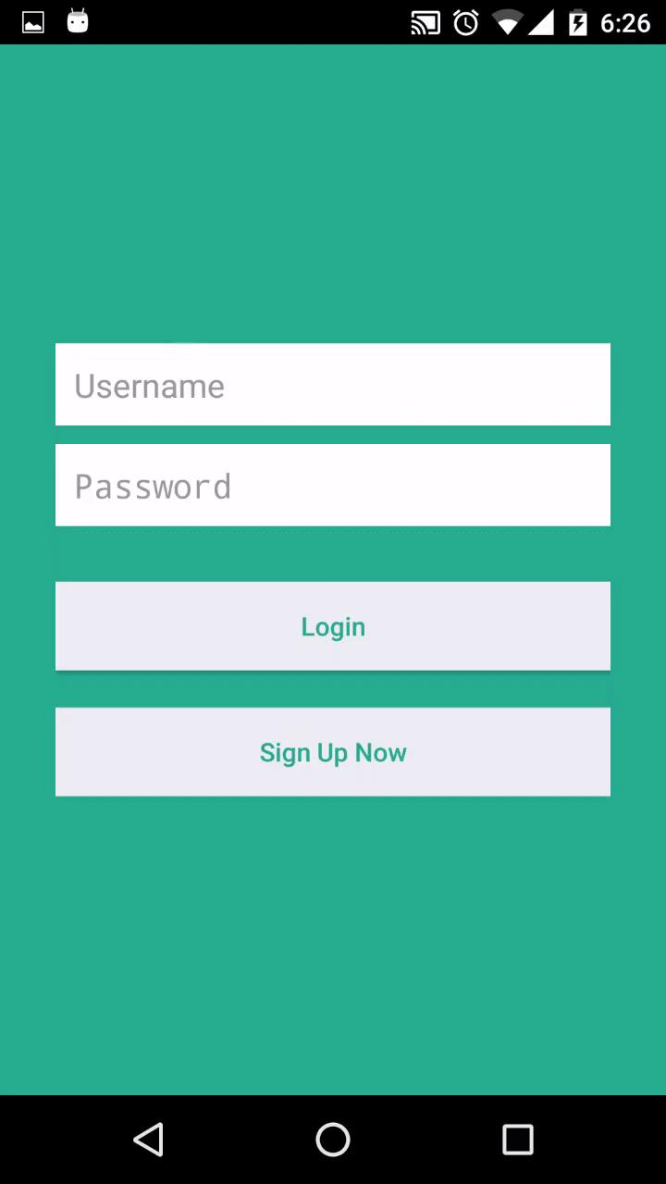

Slide 12
3. Parking Management System
Ties into the authorization feature of the app, hence available to users who have signed up for the app.
User can register their car with the NCSU transportation department using their license plate.
In case a user gets a parking ticket, they can see the ticket and amount in the app.
By tying into the Shibboleth system the user can also pay for the ticket, right from within the app.

Slide 14

Testing the Application
Test metrics:
We presented our app to 16 NCSU students.
Explained the problem we are working on and the 3 solutions we’ve proposed.
The students used our app and saw all 3 of the solutions we’ve developed.
We then asked them to give us a short survey about what they thought about our app.
We also collected some telemetry from the app by using a combination of log files and Google Analytics.

Slide 15
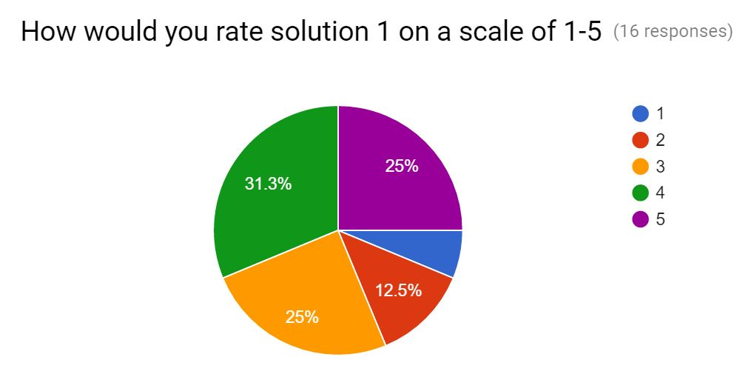
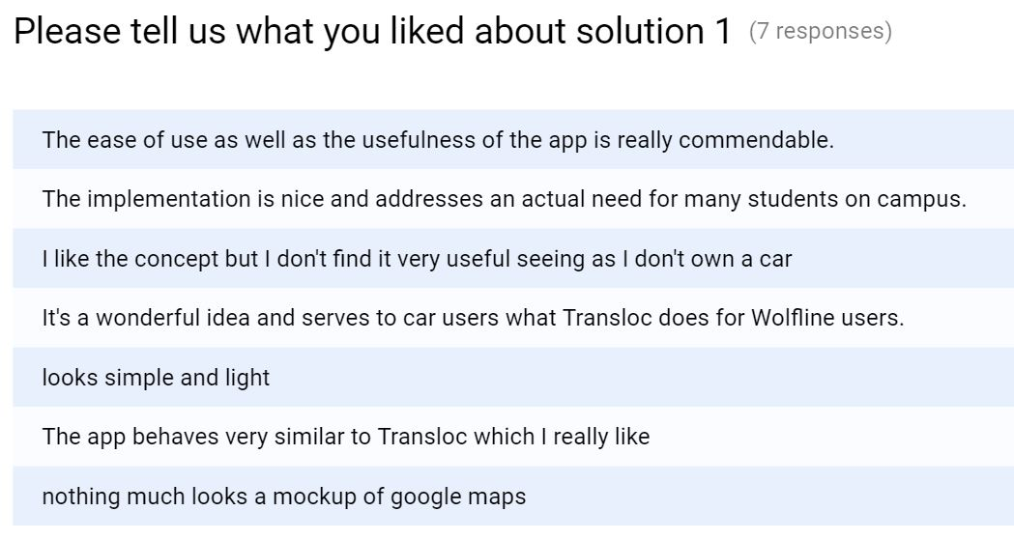
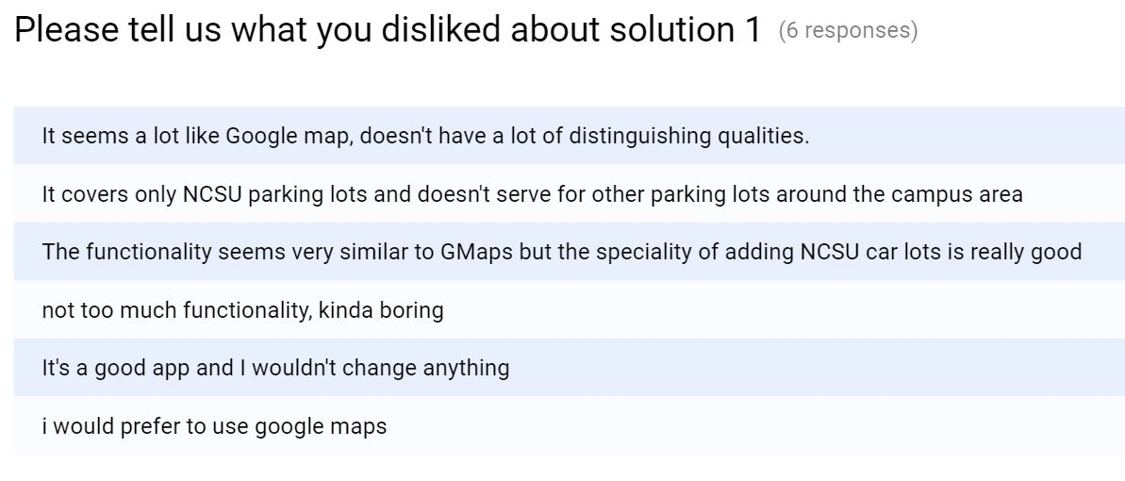

Slide 16
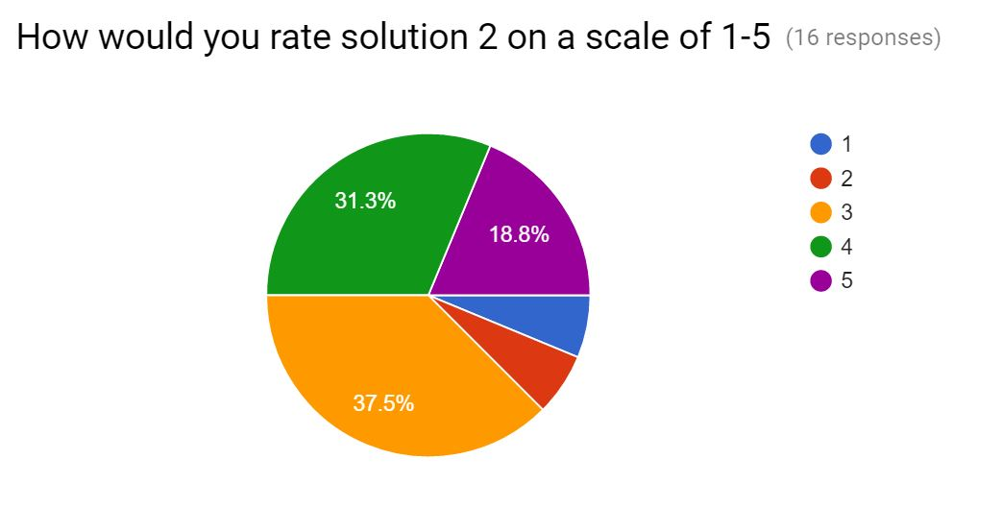
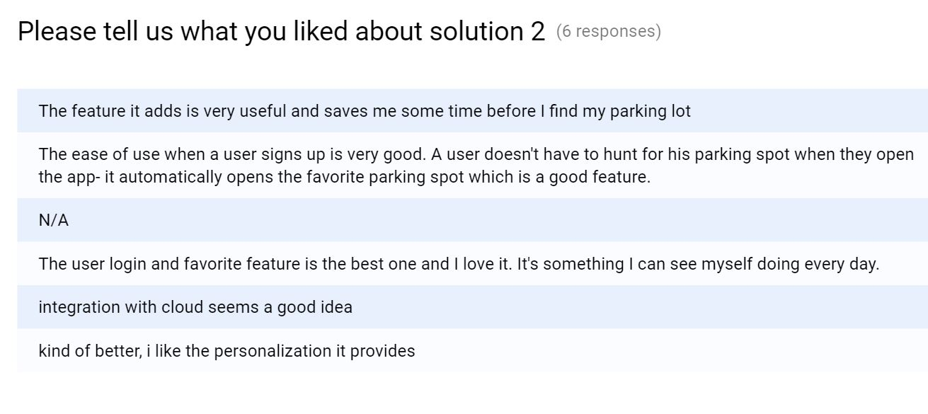
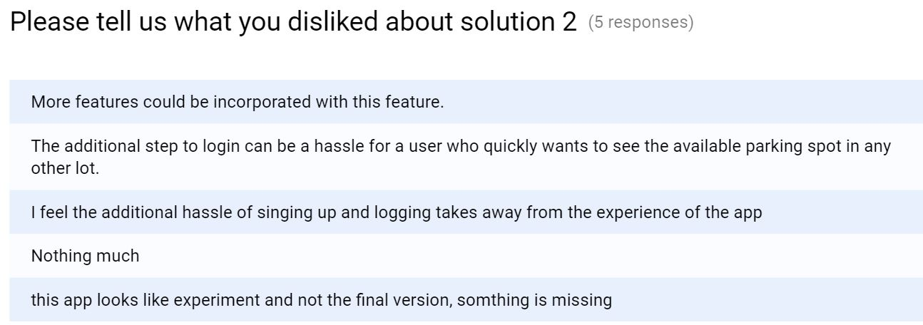

Slide 17
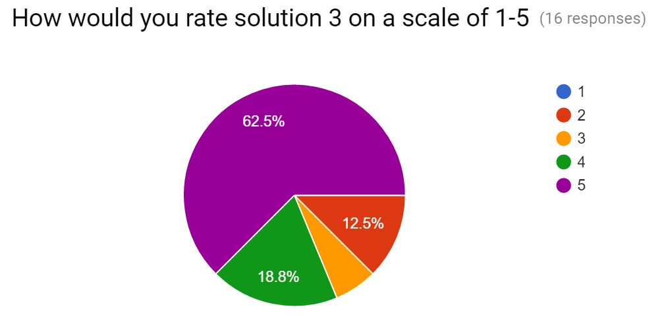
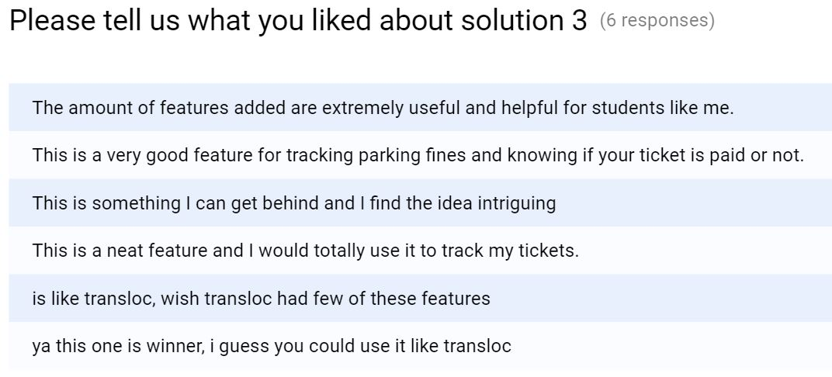
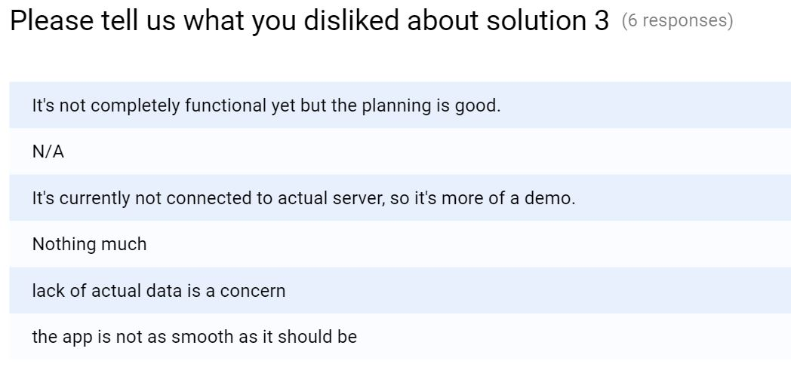

Slide 18
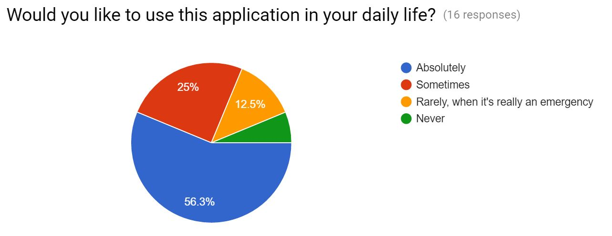
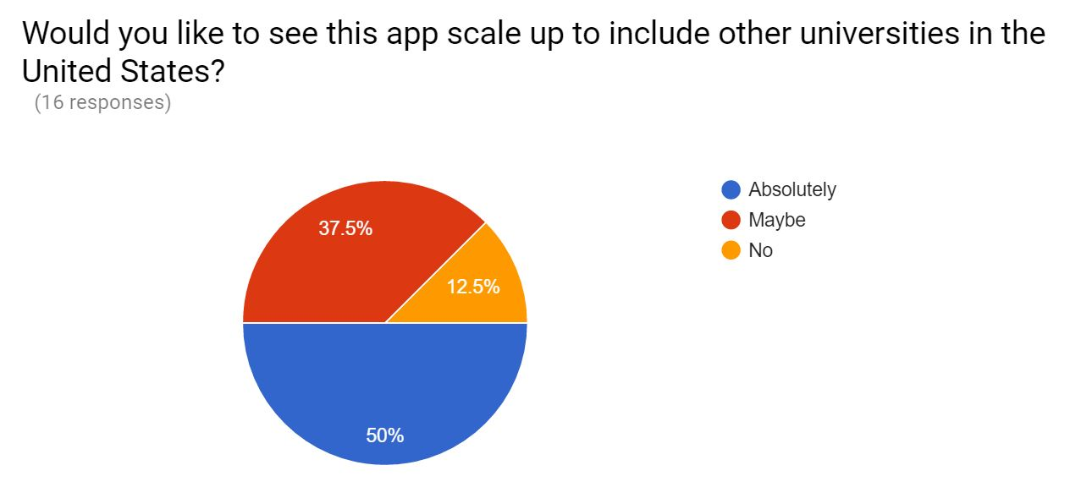

Slide 19
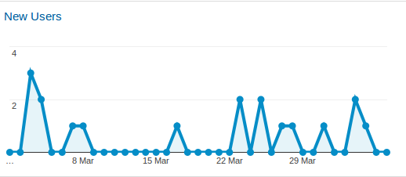
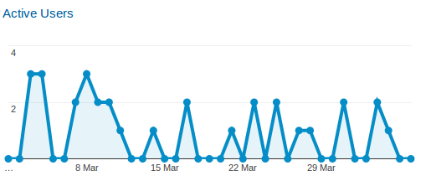
Telemetry
We used Google Analytics to obtain telemetry for the app, and also logged the latitude, longitude and the frequency of clicking the “Show Current Location” button.

Slide 20
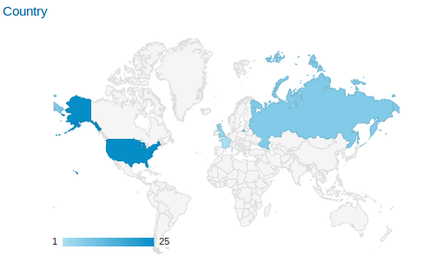
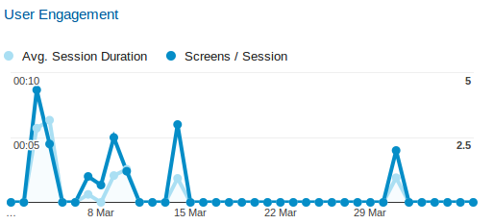
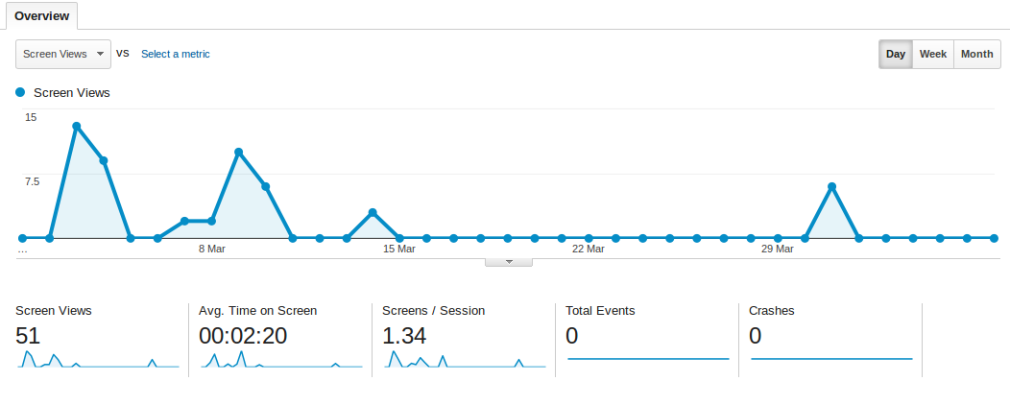

Slide 21
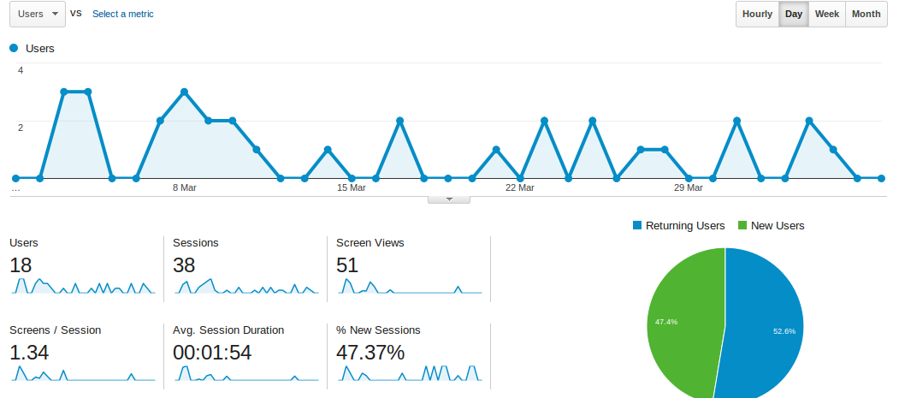
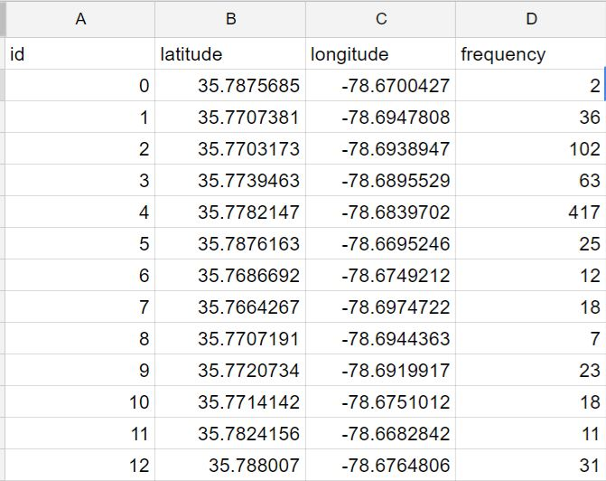

Slide 22

Results
From the user survey results, Solution 3 comes out as the “best” solution.
Users thought that solution 3 offered the most comprehensive solution to the problems they faced.
It was our thinking that Solution 1 would come out as the best solution, as we felt it was the most simplest and feature rich solution.
However the users felt that solution 3, although not fully developed due to the tie-ups required with a number of external agencies offered a more promising solution.
And as you all know.. The customer is always right. So we conclude from our findings that solution 3 comes out as the best result.

Slide 23

Limitations
The idea of building our parking app is not the perfect solution, nor the most comprehensive.
The more we thought about the problem, the more the scope of the project increased.
Our solutions involved connecting to multiple external agencies; NCSU transport department and Shibboleth authentication system are just 2 examples.
We have used mock data to replicate the data obtained from external agencies.
We have NOT connected our app to any NCSU server or used any of these services.
We need both hardware and software support to implement all our ideas into the app.
The point of the project was to find and test the solutions to a problem we’ve identified, NOT to get into the nitty gritty of connecting to these services.

Slide 24


Slide 25


